Slide 1
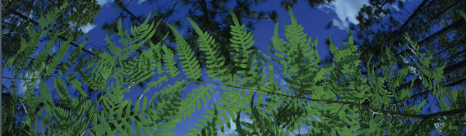



Climatic Processing Overview
Shelly Gaynor
University of Florida
BiotaPhy

Slide 2
What data are we using?

Slide 3
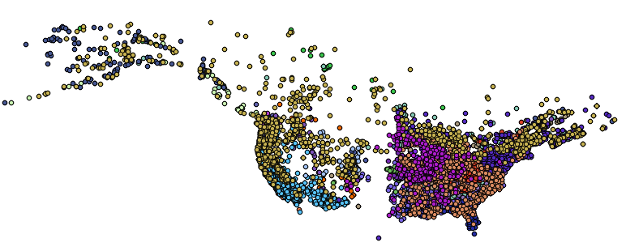
What data are we using?
1. Georeferenced occurrence records

Slide 4
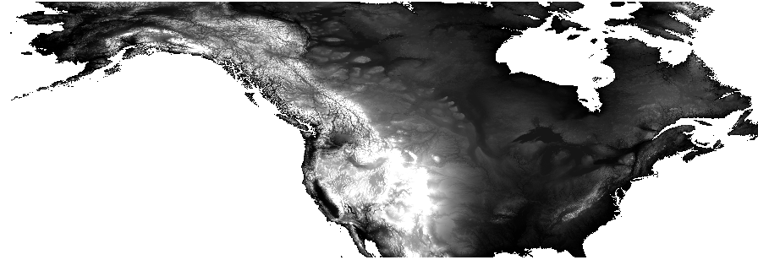
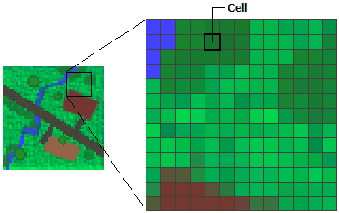
What data are we using?
2. Gridded abiotic data layers (or Raster)
Source: ArcMap

Slide 5
Abiotic data layers
What kinds?
Temperature, precipitation, soil, vegetation, land use
Where?
Local, USA, North America, Global
When?
Past, current, future

Slide 6
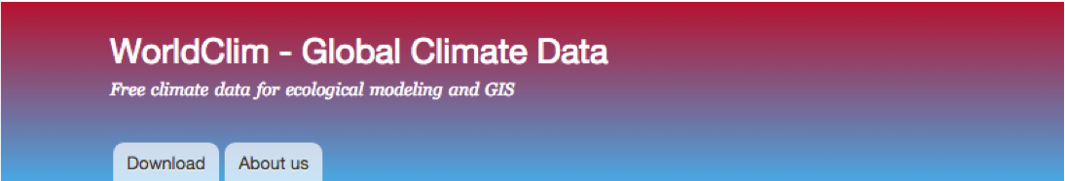


Data layer sources
WorldClim
PRISM
Unified North American Soil Map
USGS
EPA
NOAA
PMIP
AquaMaps
And more!
rWBclimate
prism
World
World
weathercan
getCRUCLdata
Canada
World
clifro
chirps
New Zealand
World

Slide 7
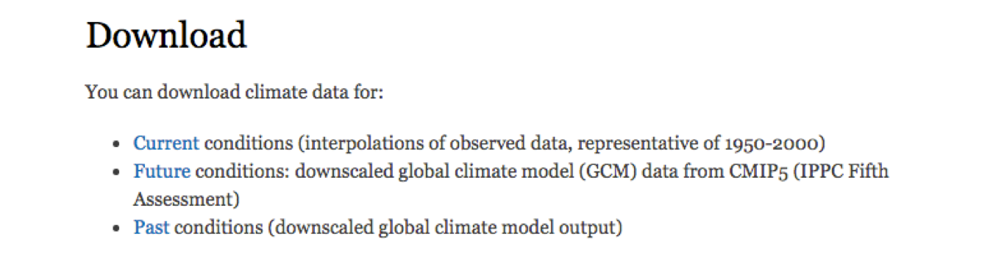
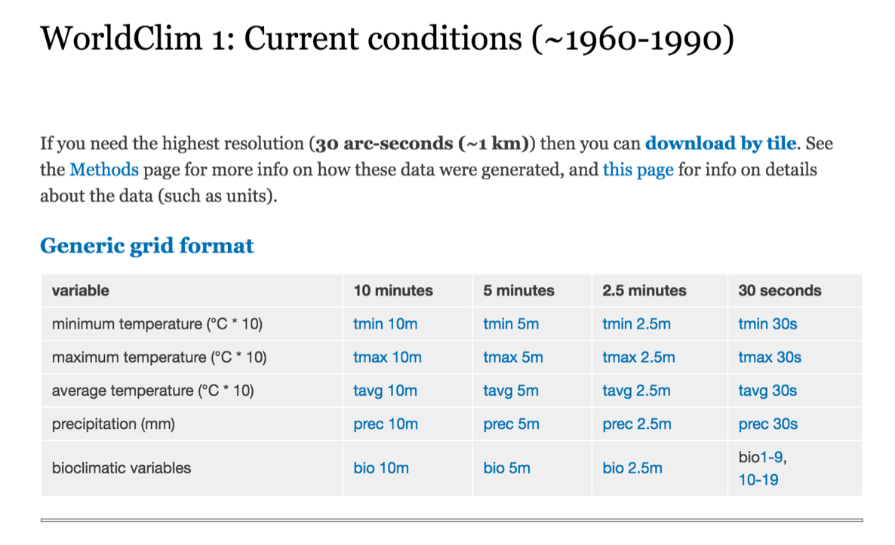
WorldClim
World
Current & Future & Past
Global climate data
Multiple resolutions
19 Bioclimatic variables derived from monthly temperature and rainfall values
Current conditions:
averaged over past 50 years
Future conditions:
climate projections from a number of global climate models with different greenhouse gas concentration trajectories
Past conditions:
Mid-Holocene, Last Glacial Maximum, Last Inter-Glacial
WorldClim 2 now available, has same 19 + new variable layers
www.worldclim.org

Slide 8
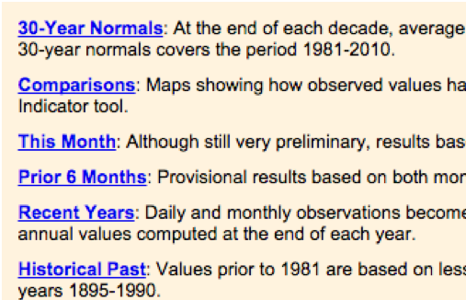
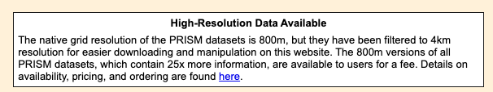
PRISM
Regional
Current & Past
Climate data for the US
More precise than WorldClim
Data available from 1895 to present
Lots of data and tools to explore
www.prism.oregonstate.edu

Slide 9
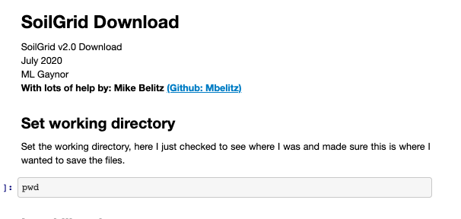
Soil Sources
SoilGrids2.0:
https://soilgrids.org
Entire globe
Eight characteristics of topsoil and subsoil
2.5 arc second resolution
mgaynor1/long-winded-scripts/SoilGridDownload/

Slide 10
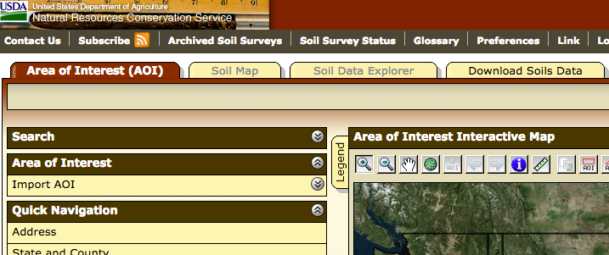
Soil Sources
SoilGrids2.0:
https://soilgrids.org
Entire globe
Eight characteristics of topsoil and subsoil
2.5 arc second resolution
USGS: http://websoilsurvey.sc.egov.usda.gov/App/HomePage.htm
US only
Need to define area of interest
Big files and tough to get large areas

Slide 11
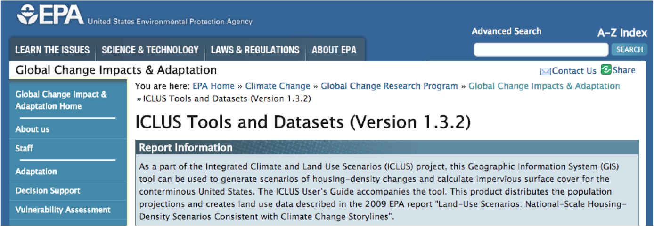
EPA
http://cfpub.epa.gov/ncea/global/recordisplay.cfm?deid=257306
Land use
County population projections
Housing density projections
Percent impervious surface projections
Notes:
amount of pavement

Slide 12
Other resources
Paleoclimate data
NOAA (NCEI):https://www.ncdc.noaa.gov/data-access/paleoclimatology-data/datasets
PMIP: https://pmip.lsce.ipsl.fr/
PaleoClim: http://paleoclim.org/
Aquatic Environments
AquaMaps: http://www.aquamaps.org/main/envt_data.php
Hourly or Daily data:
OGIMET: ogimet.com
Daymet: https://daymet.ornl.gov/

Slide 13
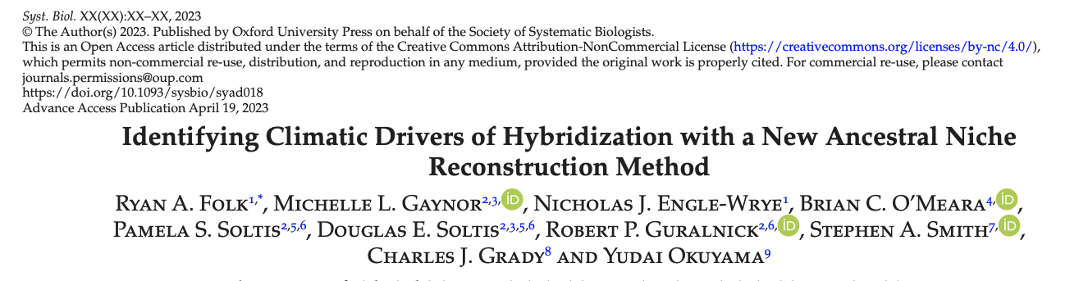
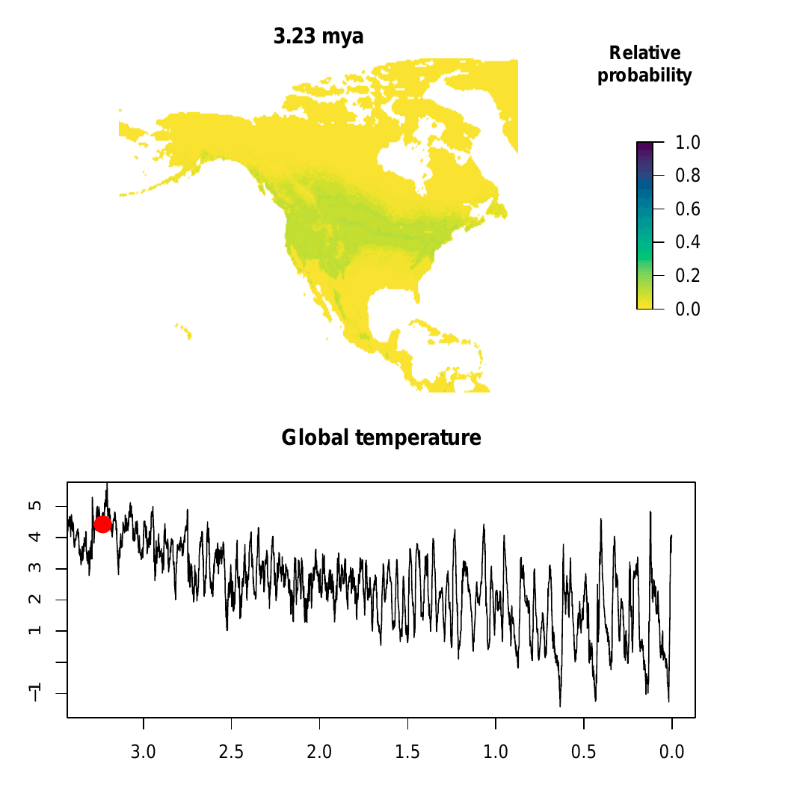
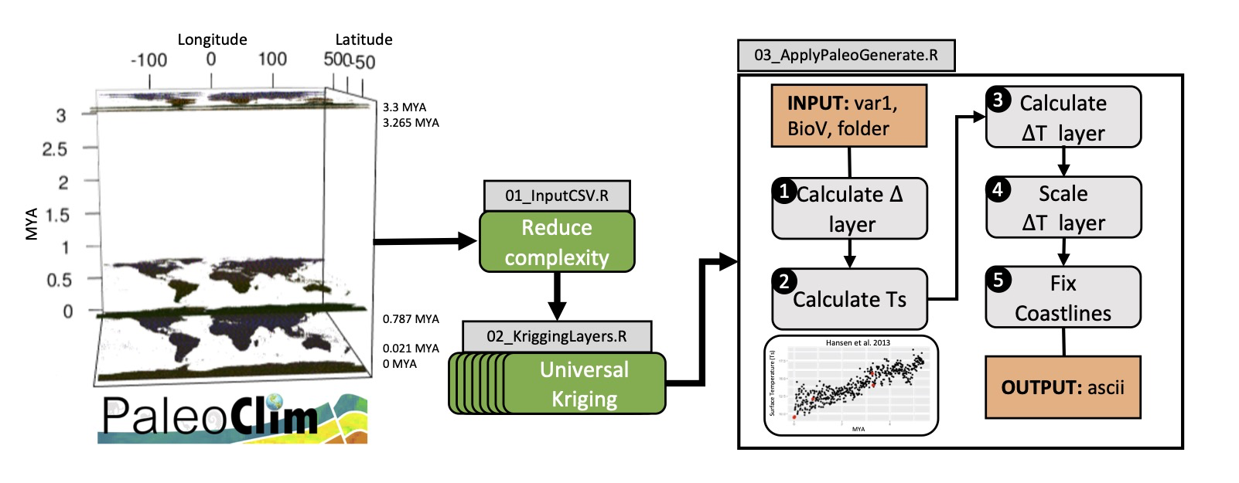

mgaynor1/paleogenerate
Folk & Gaynor et al. 2023. Systematic Biology.

Slide 14
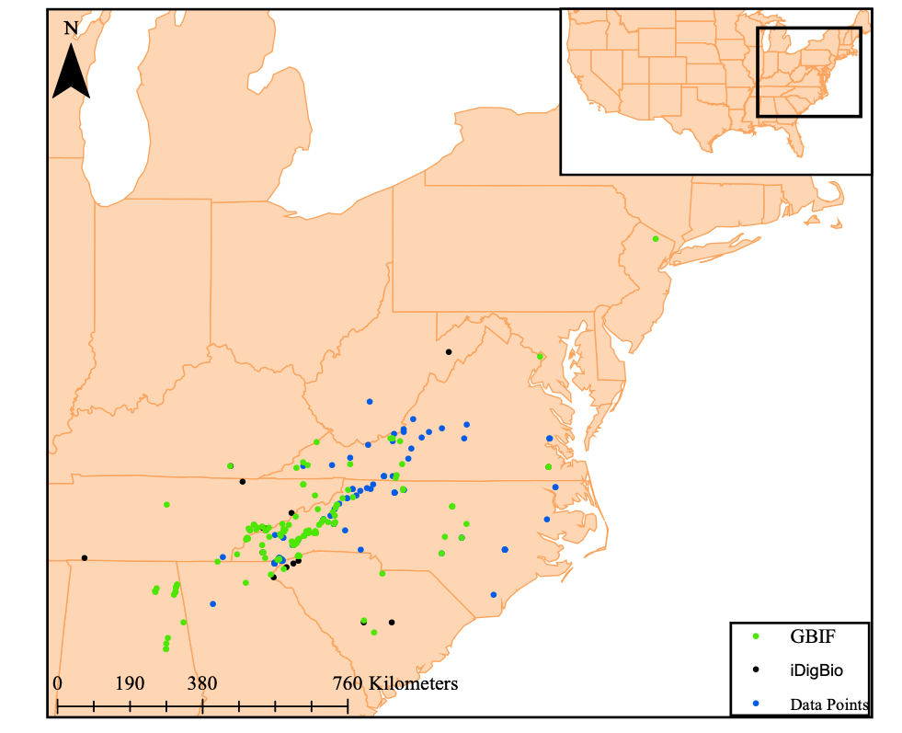
Cleaning Climatic Layers
Gaynor et al. 2018

Slide 15
Cleaning Climatic Layers
Obtain gridded abiotic data layers
Crop layers to the shared accessible area
Select layers for ecological niche modeling
Create species-specific training layers
Gaynor et al. 2018

Slide 16
Cleaning Climatic Layers
Obtain gridded abiotic data layers
Crop layers to the shared accessible area
Convex hull
Gaynor et al. 2018

Slide 17
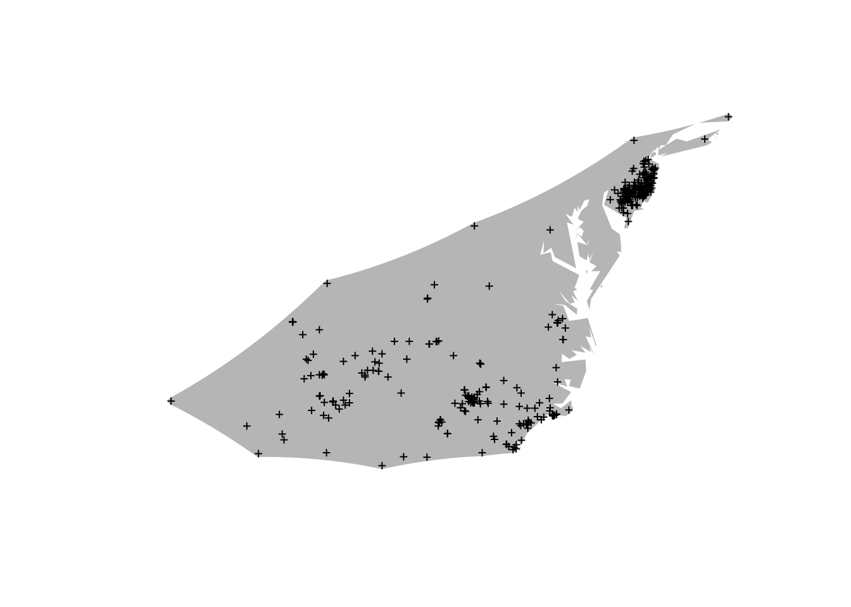
2. Crop layers to the shared accessible area
Accessible area can be defined based on:
species ecology
dispersal ability
geographical barriers
alpha-hull: piecewise series of linear simple curves
convex-hull is a type of alpha-hull

Slide 18
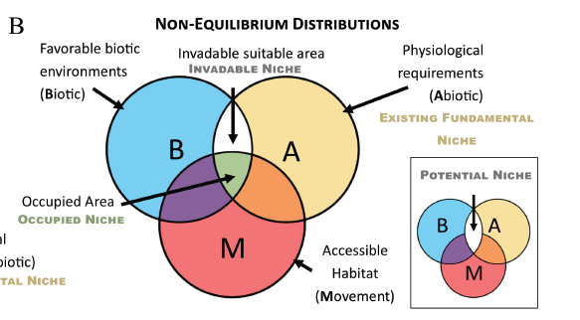
2. Crop layers to the shared accessible area
Accessible area can be defined based on:
species ecology
dispersal ability
geographical barriers
Brown and Carnaval. 2019. A tale of two niche: methods, concepts, and evolution. Frontiers of Biogeography.

Slide 19
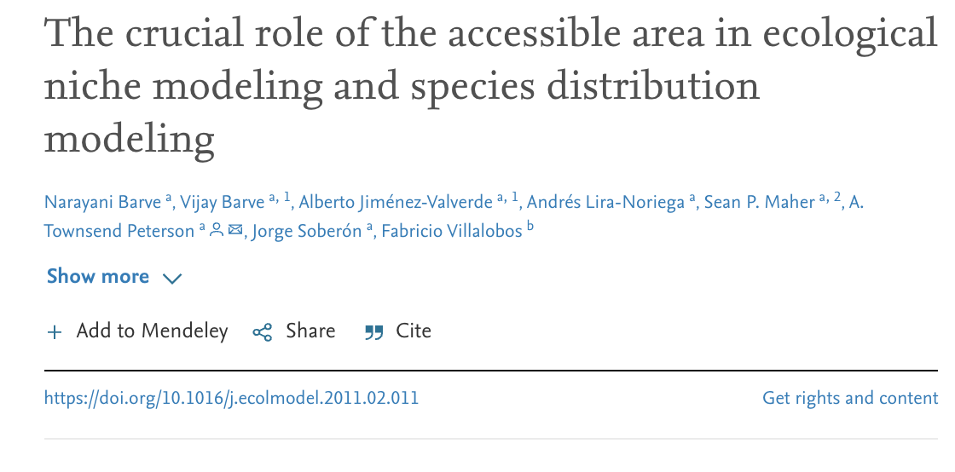
2. Crop layers to the shared accessible area
More area, AUC increased.
higher model significance as buffer size increased

Slide 20
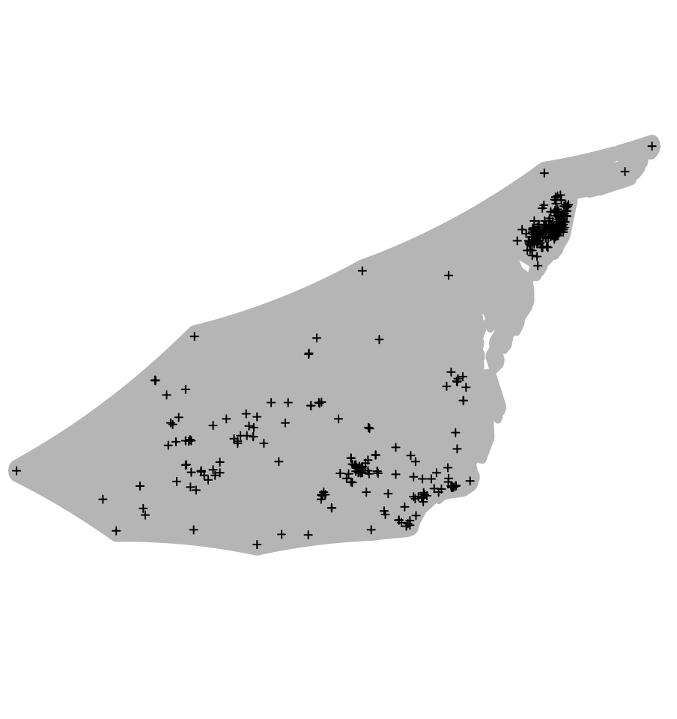
2. Crop layers to the shared accessible area
alpha-hull
alpha-hull + buffer

Slide 21
2. Crop layers to the shared accessible area
Defining the buffer:
Identify clear distributional boundaries and ecoregions using the World Wildlife Fund Terrestrial Ecoregions (see Rautsaw et al. 2022.)
Buffer size species-specific and based on the dispersal potential (see Naranjo et al. 2022)
80th quantile of the max distance between points (here)

Slide 22
2. Crop layers to the shared accessible area
Point-based buffers!
Many options for defining accessible area
Melton et al. 2022. Global Ecology and Biogeography.
Notes:
. Climate data processing was then conducted by generating a polygon around the preliminarily cleaned occurrence data (step B) using the circles function from the R package ‘dismo.’ The diameter of the point buffers is equal to the mean point-to-point distance for each species. E) Finally, the polygon is buffered by a diameter of 0.25 degree. This produces an overall polygon around the points with a buffer distance of 0.25 degrees plus the mean point-to-point distance for the species.

Slide 23
3. Select layers for ecological niche modeling
PCA | PC1 + PC2 = ~95% | Reduces variables to axis
Pearson correlation | Removes variables > |0.80| | Removes correlated variables
Variable Inflation Factor | Removes variables > 10 | Removes collinear variables

Slide 24
3. Select layers for ecological niche modeling
A correlation test is performed on all 19 BioClim layers.
Removes variables > |0.80|
bio2
bio3
bio5
bio7
bio8
bio9
bio15
bio18
bio19
Melton et al. 2022. Global Ecology and Biogeography.

Slide 25
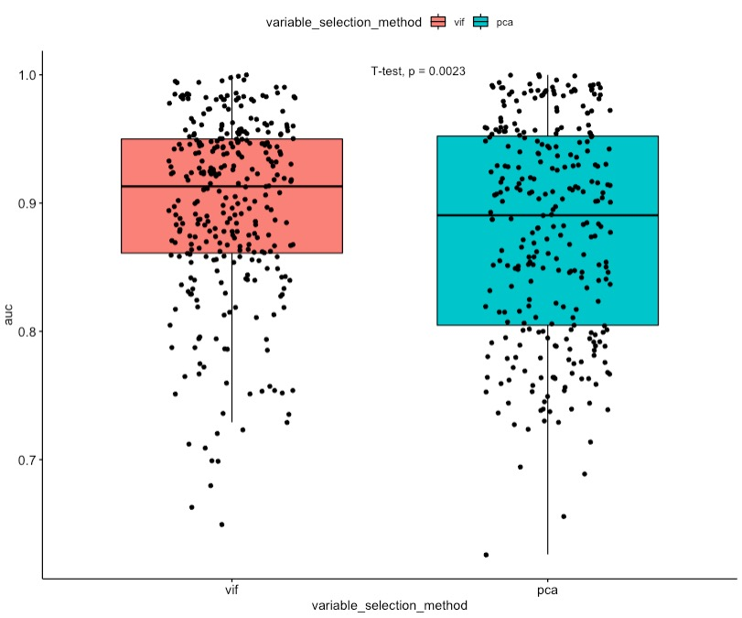
3. Select layers for Ecological Niche Modeling
PCA vs VIF with permutation
AUC was significantly higher in models generated using the VIF method
Based on 109 species in the subfamily Crotalinae (Viperidae)
PCA with 75% collinearity cutoff, each variable contribution had to be >5%.
VIF < 10, permutation importance > 1%
Rautsaw et al. 2022. Scientific Data.

Slide 26
3. Select layers for ecological niche modeling
Demo:
1. Pearson Correlation
Removes variables > |0.80|
2. VIF and permutation importance
Run MaxEnt and identify the permutation importance to remove any variables with 0% permutation importance.
Then calculated VIF, remove the variable with the highest VIF and lowest permutation importance. Repeat until all VIF values are less than 10.

Slide 27
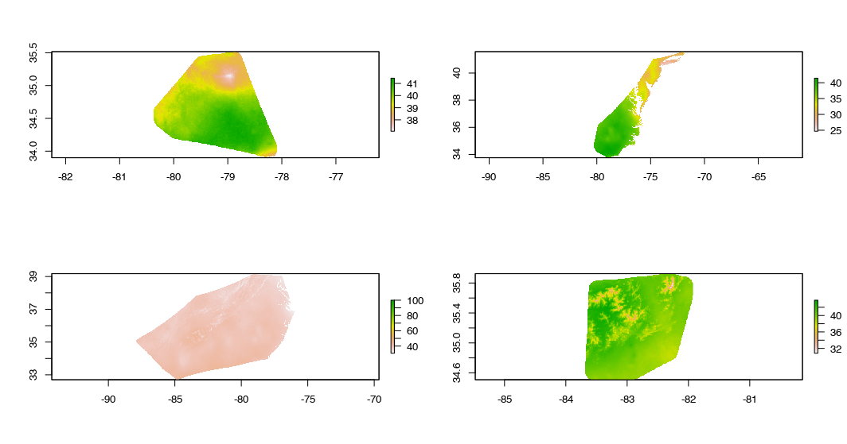
4. Create species-specific training layers
Crop and buffer selected layers for each species!

Slide 28
Layer Processing
Need layers in ASCII format
Clip layers to fit your desired range
Convex hull + Buffer
Remove correlated layers based on a Pearson Correlation.

Slide 29
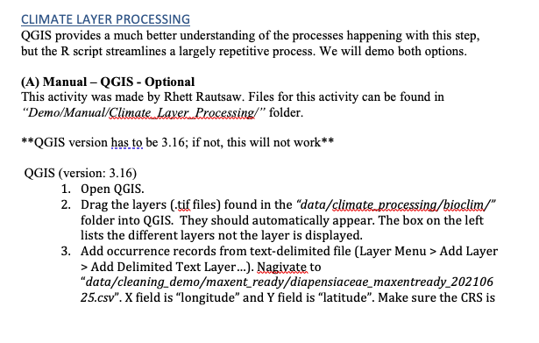
Layer Processing
For an intro to QGIS:
Github: RhettRautsaw/GIS_Tutorial

Slide 30
Layer Processing
Need layers in ASCII format
Clip layers to fit your desired range
Dynamic alpha hull
+ 80th quartile buffer
04_ClimateProcessing.R

Slide 31
Layer Processing
Need layers in ASCII format
Clip layers to fit your desired range
Dynamic alpha hull
+ 80th quartile buffer
Remove layers with collinearity based on variable inflation factor and permutation importance.
04_ClimateProcessing.R

Slide 32
Layer Processing
Need layers in ASCII format
Clip layers to fit your desired range
Dynamic alpha hull
+ 80th quartile buffer
Remove layers with collinearity based on variable inflation factor and permutation importance.
Define shared projection layers and training layers.
04_ClimateProcessing.R

Slide 33
Layer Processing
04_ClimateProcessing.R

